Slide 1
CSCE 689: Special Topics in Modern Algorithms for Data Science
Week 1: Probability basics
Samson Zhou

Slide 2
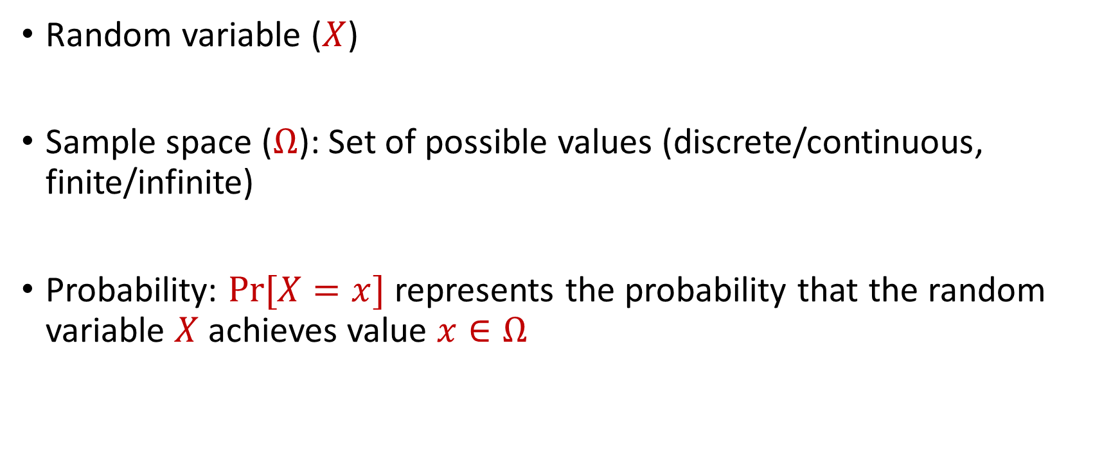
Probability Basics
Random variable ($X$)
Sample space ($Ω$): Set of possible values (discrete/continuous, finite/infinite)
Probability: $Pr[X=x]$ represents the probability that the random variable $X$ achieves value $x∈Ω$

Slide 3
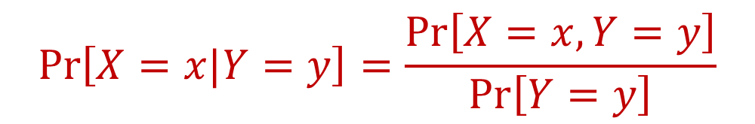
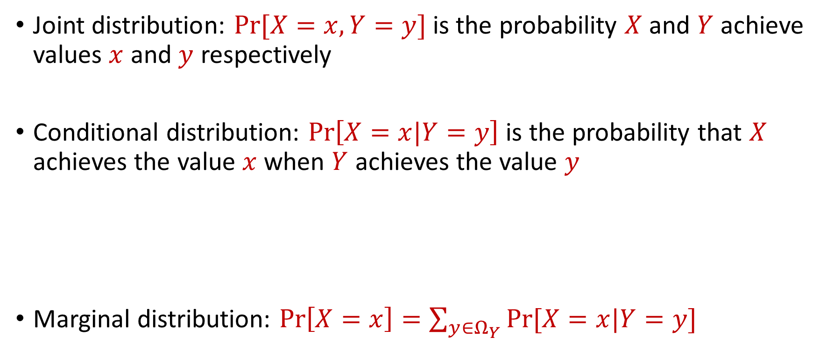
Joint and Conditional Probability
Joint distribution: $Pr[X=x, Y=y]$ is the probability $X$ and $Y$ achieve values $x$ and $y$ respectively
Conditional distribution: $Pr\left[X=x|Y=y\right]$ is the probability that $X$ achieves the value $x$when $Y$ achieves the value $y$
Marginal distribution: $Pr\left[X=x\right]=\sum_{y∈Ω_{Y}}{Pr[X=x|Y=y]}$
$$Pr\left[X=x|Y=y\right]=\frac{Pr\left[X=x, Y=y\right]}{Pr\left[Y=y\right]}$$

Slide 4

Independence
Random variables $X$ and $Y$ are independent if $Pr\left[X=x\right]=Pr\left[X=x|Y=y\right]$ for all possible outcomes $x∈Ω_{X}$, $y∈Ω_{Y}$

Slide 5


Expected Value
The expected value of a random variable $X$ over $Ω$ is:
Linearity of expectation: $E\left[X+Y\right]=E\left[X\right]+E\left[Y\right]$
$$E\left[X\right]=\sum_{x∈Ω}{Pr\left[X=x\right]⋅x}$$

Slide 6


Moments
For $p>0$, the $p$-th moment of a random variable $X$ over $Ω$ is:
$$E\left[X^{p}\right]=\sum_{x∈Ω}{Pr\left[X=x\right]⋅x^{p}}$$

Slide 7

Variance
The variance of a random variable $X$ over $Ω$ is:
Linearity of variance for independent random variables: $Var\left[X+Y\right]=Var\left[X\right]+Var\left[Y\right]$
$$Var\left[X\right]=E\left[X^{2}\right]−{\left(E\left[X\right]\right)}^{2}$$

